Slide 1

Welcome to Firewall management
Presented by Jacques Verryn

Slide 2
Agenda
Introduction to Firewalls
Firewall Rules and Policies
The Role of VPNs in Security
All is safe ! Or ?
Playing with AWS Security Groups

Slide 3
Overview of Firewalls
Definition:
A firewall is a network security system that monitors and controls incoming and outgoing network traffic based on predetermined security rules.
Purpose:
Protect internal networks from external threats, control access to network services, and ensure data confidentiality and integrity.
Role in Network Security:
Firewalls act as a barrier between trusted internal networks and untrusted external networks (such as the internet).

Slide 4
Firewall deployments
Network-Based Firewalls:
Positioned between two networks, typically between a private network and the public internet.
Host-Based Firewalls:
Software-based firewalls installed on individual devices to protect against threats targeting specific machines.
Hardware vs. Software Firewalls:
Pro’s / Con’s
Use cases

Slide 5
Types of Firewalls
Packet Filtering:
Analyzes network packets and filters based on IP, port, and protocol.
Stateful Inspection:
Tracks the state of active connections and makes decisions based on connection states.
Proxy Firewalls:
Acts as an intermediary for requests, filtering out malicious traffic by handling requests on behalf of the user.
Next-Generation Firewalls (NGFW):
Advanced firewalls offering features such as deep packet inspection, application awareness, and integrated threat intelligence.

Slide 6
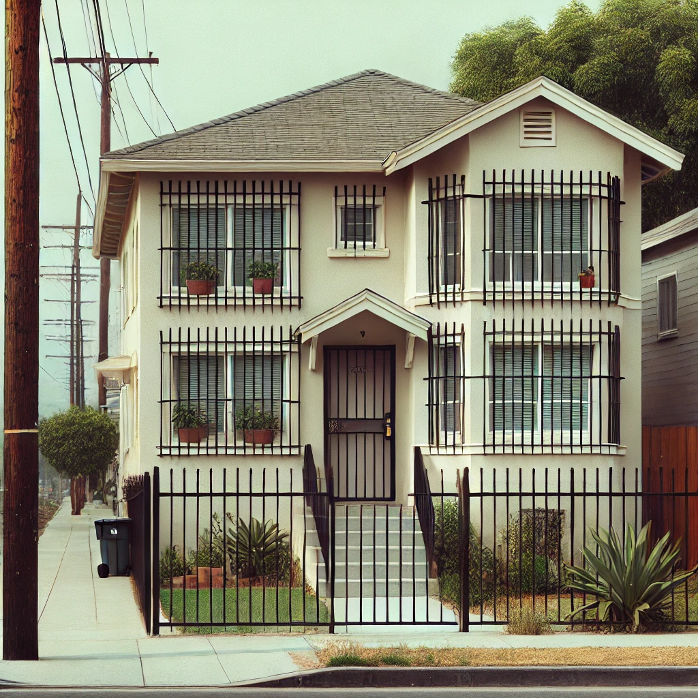
House A
Locking doors
Fence
Security Gate
Barred Windows

Slide 7

House B
Locking doors
Electric Fence
Security Gate

Slide 8

House C
Locking doors
Electric Fence
Security Gate
Barred Windows

Slide 9
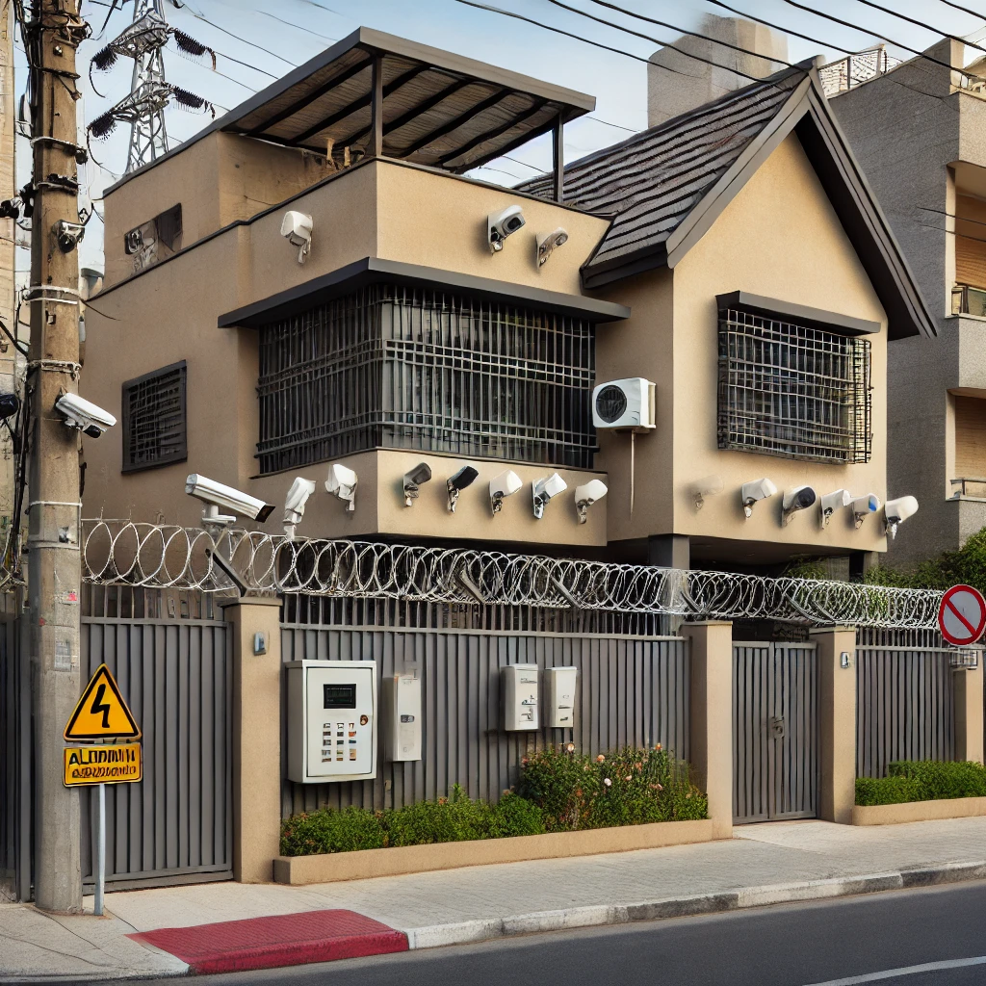
House D
Locking doors
Electric Fence
Security Gate
Barred Windows
Alarm System
Cameras

Slide 10
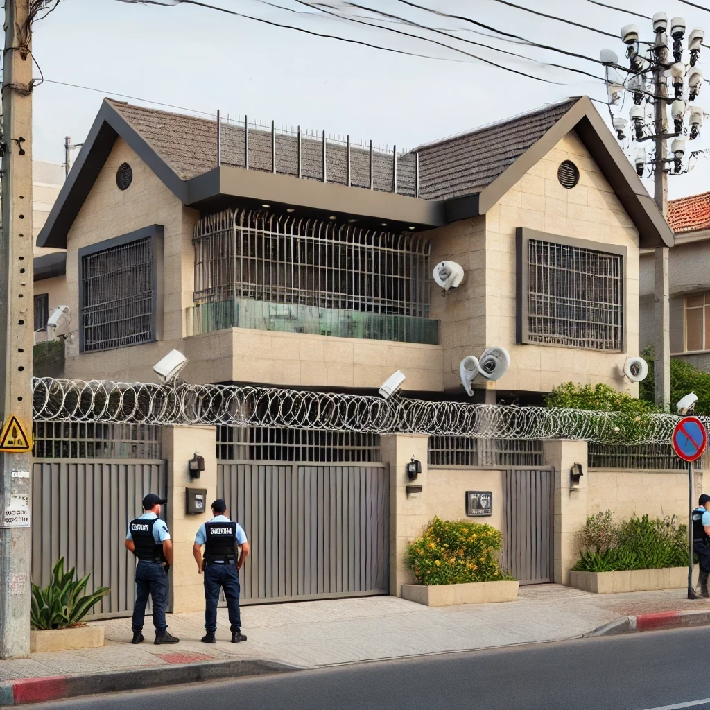
House E
Locking doors
Electric Fence
Security Gate
Barred Windows
Alarm System
Cameras
Security Guards

Slide 11
Firewall Rules and Policies
Understanding Firewall Rules
Basic Structure:
Source address, destination address, port number, and protocol (e.g., TCP, UDP).
Common Protocols:
HTTP (port 80), HTTPS (port 443), FTP (port 21), SSH (port 22), etc.
Rule Action:
Allow or deny based on rule evaluation.

Slide 12
Firewall Rules and Policies
Rule Precedence and Ordering
How rules are processed in order from top to bottom. Conflicting rules and their impact on network access.
Importance of correctly ordering rules to avoid conflicts and security breaches.

Slide 13
The Role of VPNs in Security
Introduction to VPNs
What is a VPN?:
Virtual Private Network (VPN) encrypts data traffic between two networks or between a user and a network.
Purpose:
Ensures secure communication over potentially insecure networks (e.g., the public internet).
At office feel.

Slide 14
The Role of VPNs in Security
How VPNs Complement Firewalls
VPNs provide an additional layer of security by encrypting data in transit, making it more difficult for attackers to intercept sensitive information.
Combining firewalls and VPNs: Firewalls filter traffic, and VPNs secure the communication.

Slide 15
The Role of VPNs in Security
Considerations before enrolling a device on a vpn
Device Compliance Checks
Health Check Before Connection
Ensure the device complies with company security policies before it’s allowed to connect via VPN. This can include checks for:
Latest security patches installed.
Active and up-to-date antivirus/antimalware software.
Disk encryption enabled.
Authentication Mechanisms
Network Segmentation

Slide 16


